Slide 2
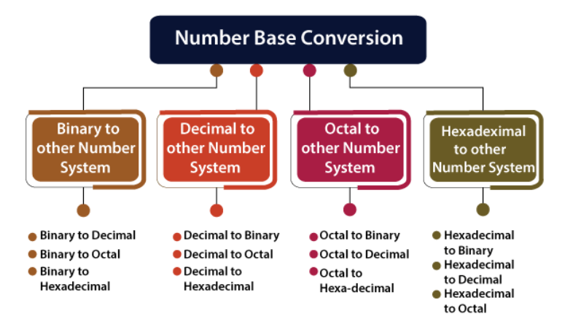

Slide 3
Number systems are the technique to represent numbers in the computer system architecture, every value that you are saving or getting into/from computer memory has a defined number system.
BINARY NUMBER SYSTEM:A Binary number system has only two digits that are 0 and 1. Every number (value) represents with 0 and 1 in this number system. The base of binary number system is 2, because it has only two digits.
OCTAL NUMBER SYSTEM :Octal number system has only eight (8) digits from 0 to 7. Every number (value) represents with 0,1,2,3,4,5,6 and 7 in this number system. The base of octal number system is 8, because it has only 8 digits.
DECIMAL NUMBER SYSTEM:Decimal number system has only ten (10) digits from 0 to 9. Every number (value) represents with 0,1,2,3,4,5,6, 7,8 and 9 in this number system. The base of decimal number system is 10, because it has only 10 digits.

Slide 4
HEXADECIMAL NUMBER SYSTEM:A Hexadecimal number system has sixteen (16) alphanumeric values from 0 to 9 and A to F. Every number (value) represents with 0,1,2,3,4,5,6, 7, 8, 9, A, B, C, D, E and F in this number system. The base of hexadecimal number system is 16, because it has 16 alphanumeric values. Here A is 10, B is 11, C is 12, D is 14, E is 15 and F is 16.

Slide 5
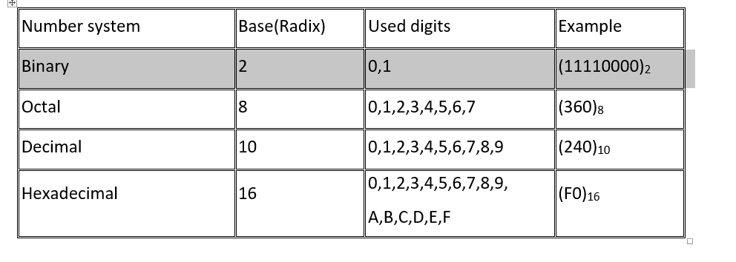

Slide 6
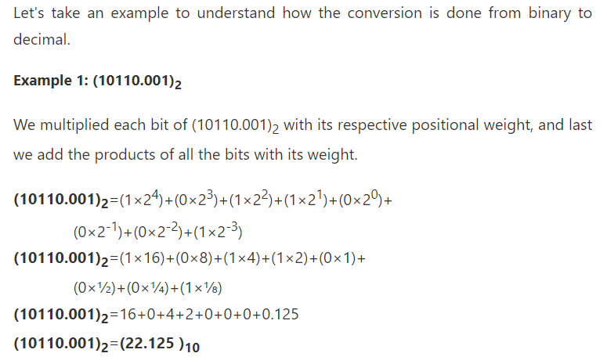
Binary to other Number Systems
Binary to Decimal Conversion

Slide 7
Binary to Octal Conversion
Example 1: (111110101011.0011)₂
1. Firstly, we make pairs of three bits on both sides of the binary point.
111 110 101 011.001 1
On the right side of the binary point, the last pair has only one bit. To make it a complete pair of three bits, we added two zeros on the extreme side.
111 110 101 011.001 100
2. Then, we wrote the octal digits, which correspond to each pair.
(111110101011.0011)₂=(7653.14)₈

Slide 8
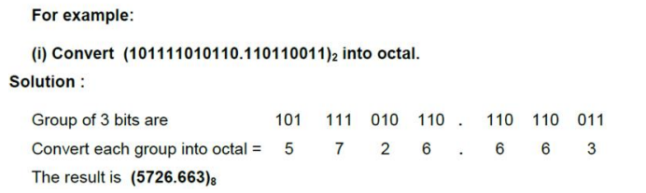

Slide 9
Binary to Hexadecimal Conversion
In the second step, we write the hexadecimal digits corresponding to each pair.
Example 1: (10110101011.0011)₂
Firstly, we make pairs of four bits on both sides of the binary point.
111 1010 1011.0011
On the left side of the binary point, the first pair has three bits. To make it a complete pair of four bits, add one zero on the extreme side.
0111 1010 1011.0011
Then, we write the hexadecimal digits, which correspond to each pair.
(011110101011.0011)₂=(7AB.3)₁₆

Slide 10
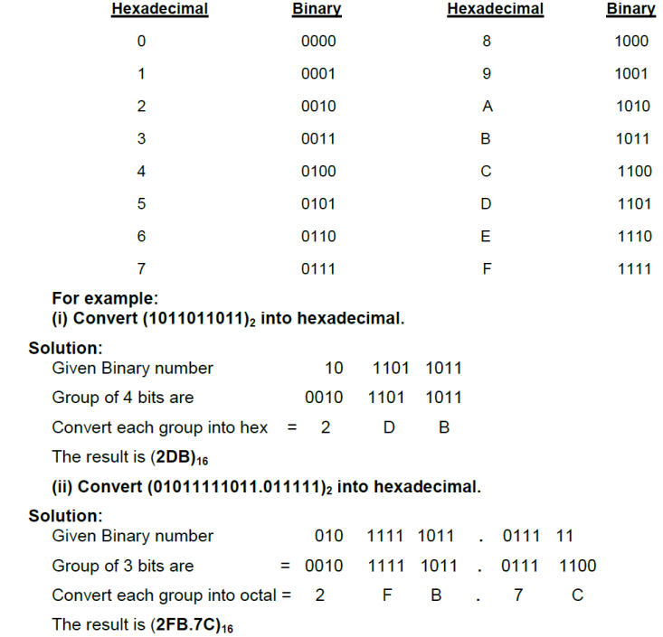

Slide 11
Decimal to other Number System

Slide 12
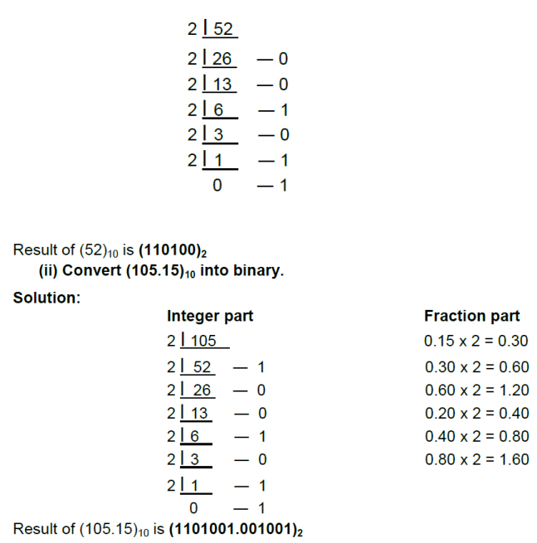
Decimal to Binary Conversion:-

Slide 13
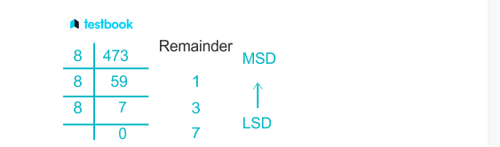
Decimal to Octal Conversion

Slide 14
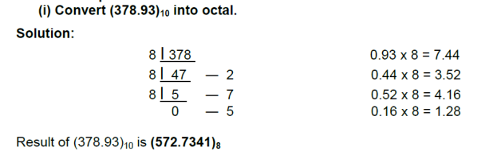

Slide 15
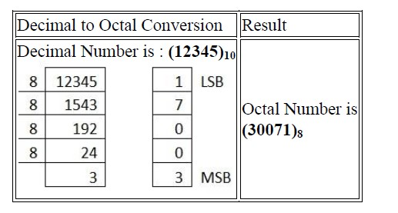

Slide 16
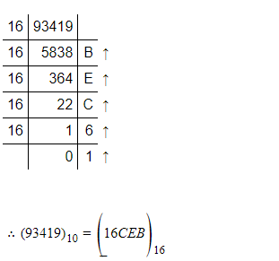
Decimal to Hexadecimal Conversion

Slide 17
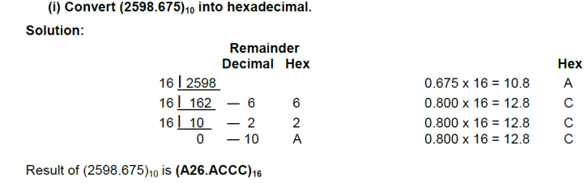

Slide 18
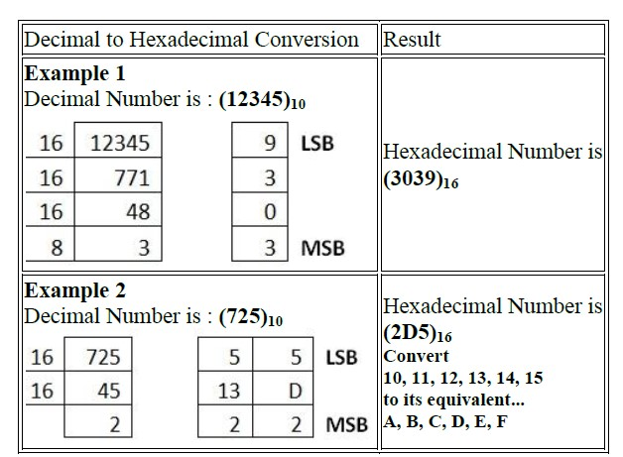

Slide 19
OCTAL NUMBER SYSTEM Octal to binary conversion
Example 1: (152.25)₈
Step 1:
We multiply each digit of 152.25 with its respective positional weight, and last we add the products of all the bits with its weight.
(152.25)₈=(1×8²)+(5×8¹)+(2×8⁰)+(2×8⁻¹)+(5×8⁻²) (152.25)₈=64+40+2+(2×1⁄8)+(5×1⁄64) (152.25)₈=64+40+2+0.25+0.078125 (152.25)₈=106.328125

Slide 20
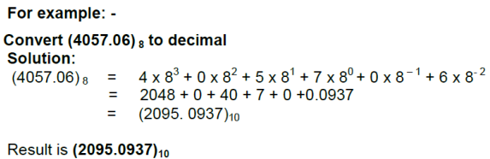

Slide 21
Octal to Binary Conversion
Example 1: (152.25)₈
We write the three-bit binary digit for 1, 5, 2, and 5
(152.25)₈=(001101010.010101)₂
So, the binary number of the octal number 152.25 is (001101010.010101)₂

Slide 22
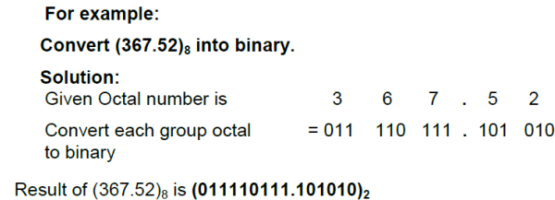

Slide 23
Octal to decimal conversion
Example 1: (152.25)₈
152.25)₈=(1×8²)+(5×8¹)+(2×8⁰)+(2×8⁻¹)+(5×8⁻²) (152.25)₈=64+40+2+(2×1⁄8)+(5×1⁄64) (152.25)₈=64+40+2+0.25+0.078125 (152.25)₈=106.328125

Slide 25
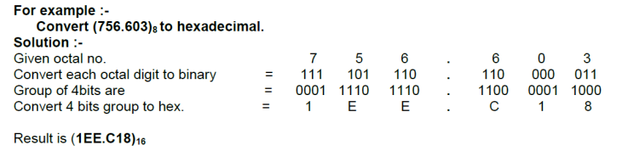
Octal to hexadecimal conversion
For conversion of octal to Hexadecimal, first convert the given octal number to binary and then binary number to hexadecimal

Slide 26
HEXADECIMAL NUMBER SYSTEM Hexadecimal to binary conversion
Example 1: (152A.25)₁₆
We write the four-bit binary digit for 1, 5, A, 2, and 5.
(152A.25)₁₆=(0001 0101 0010 1010.0010 0101)₂
So, the binary number of the hexadecimal number 152.25 is (1010100101010.00100101)₂

Slide 27
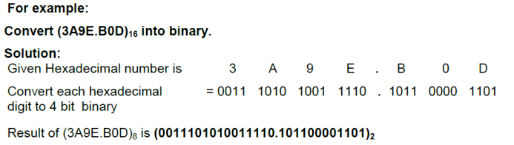

Slide 28
Hexadecimal to decimal conversion
Example 1: (152A.25)₁₆
We write the four-bit binary digit for 1, 5, A, 2, and 5.
(152A.25)₁₆=(0001 0101 0010 1010.0010 0101)₂
So, the binary number of the hexadecimal number 152.25 is (1010100101010.00100101)₂

Slide 29
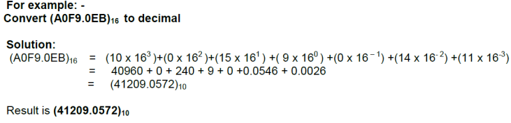

Slide 30
Hexadecimal to Octal conversion
Example 1: (152A.25)₁₆
Step 1:
We write the four-bit binary digit for 1, 5, 2, A, and 5.
(152A.25)₁₆=(0001 0101 0010 1010.0010 0101)₂
So, the binary number of hexadecimal number 152A.25 is (0011010101010.010101)₂
Step 2:
Then, we make pairs of three bits on both sides of the binary point.
001 010 100 101 010.001 001 010
4. Then, we write the octal digit, which corresponds to each pair.
(001010100101010.001001010)₂=(12452.112)₈
So, the octal number of the hexadecimal number 152A.25 is 12452.112

Slide 31
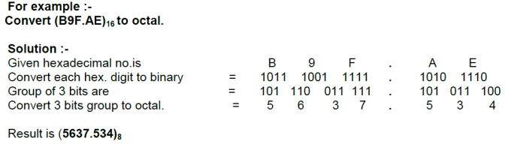

Slide 32
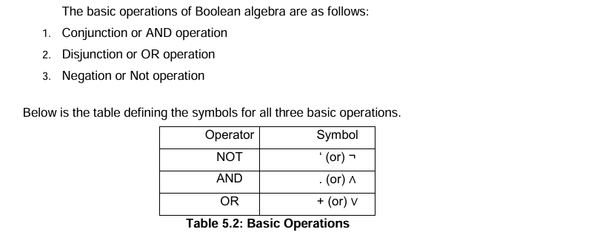
Boolean Algebra

Slide 33
LOGIC GATES
Types
• Basic gates (AND, OR, NOT)
• Universal gates (NAND, NOR)
• Special gates (EXOR, EXNOR)

Slide 34
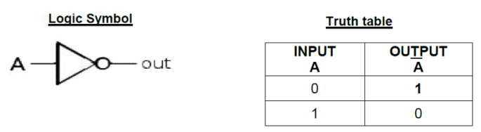
DIFFERENT TYPES OF LOGIC GATES NOT GATE (INVERTER)

Slide 35
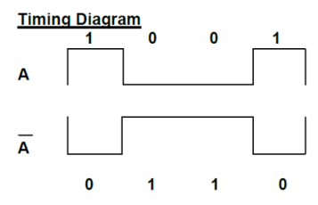

Slide 36
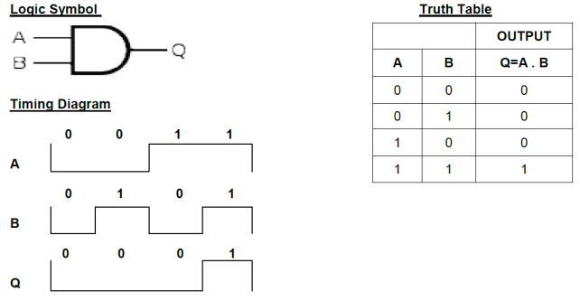
AND GATE

Slide 37
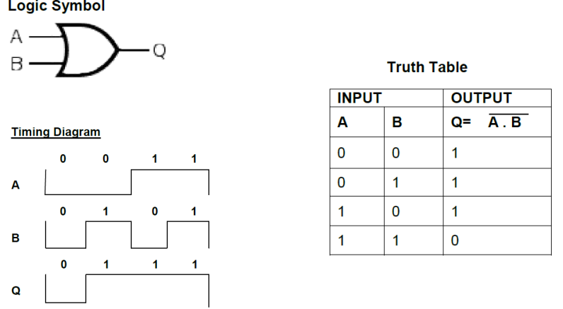
OR GATE

Slide 38
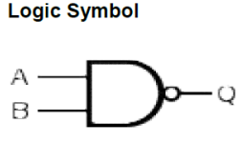
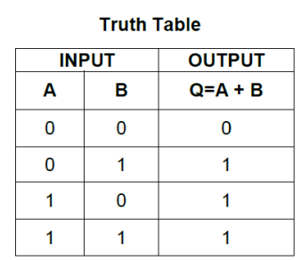
NAND GATE

Slide 39
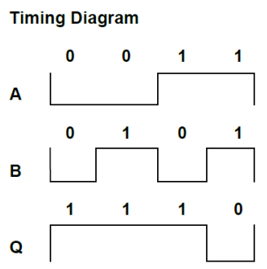

Slide 40
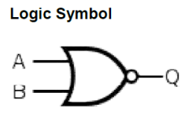
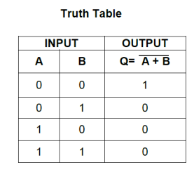
NOR GATE

Slide 41
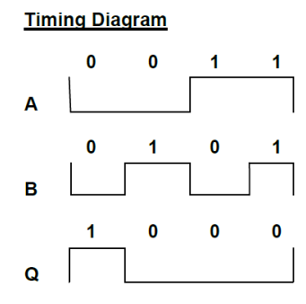

Slide 42
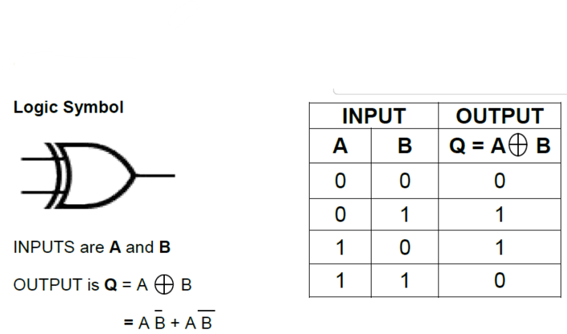
EXCLUSIVE – OR (X-OR) GATE

Slide 43
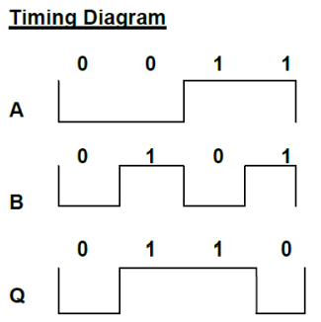

Slide 44
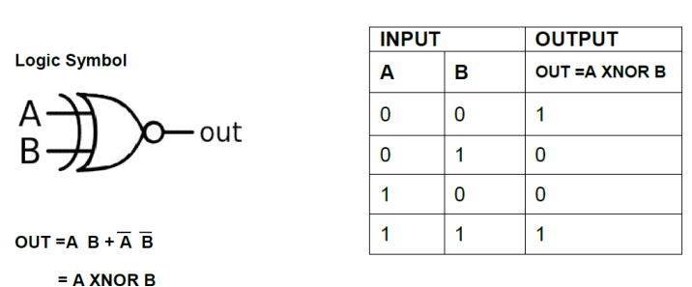
EXCLUSIVE – NOR (X-NOR) GATE

Slide 45
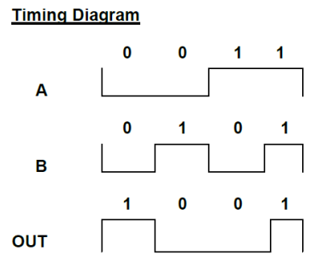

Slide 46
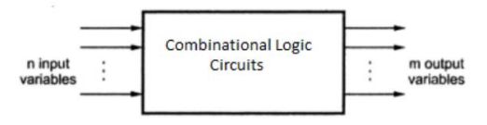
COMBINATIONAL CIRCUITS
The output of combinational circuit at any instant of time, depends only on the levels present at input terminals.
The combinational circuit do not use any memory. The previous state of input does not have any effect on the present state of the circuit.

Slide 47
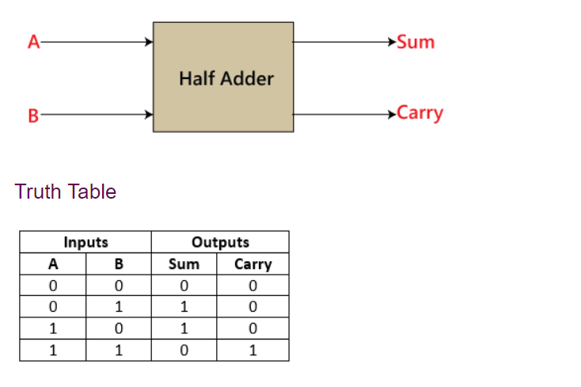
Half Adder
Sum=x'y+xy' Carry = xy

Slide 48
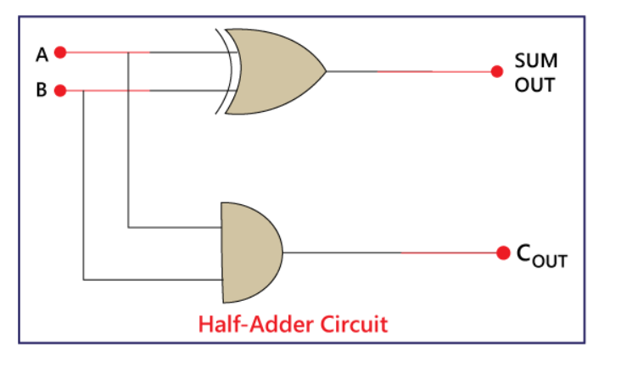

Slide 49
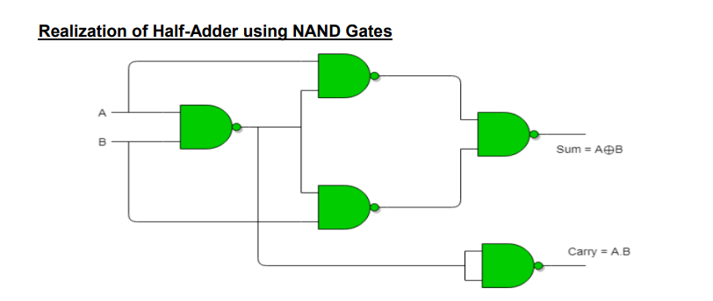

Slide 50
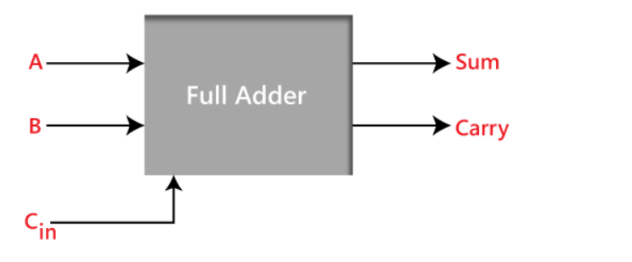
Full Adder Block diagram

Slide 51
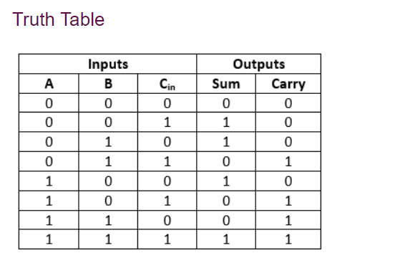

Slide 52
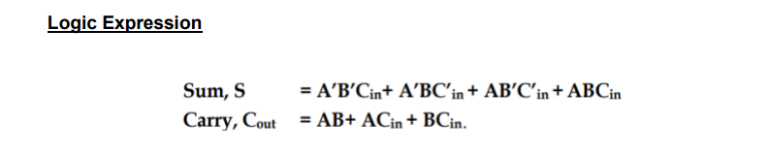

Slide 53
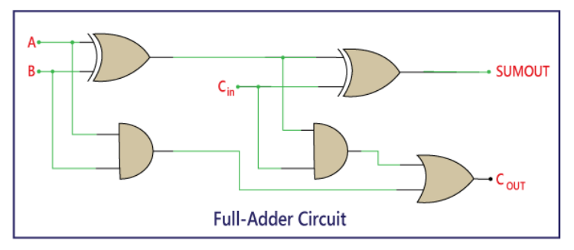

Slide 54
MULTIPLEXER (MUX)
A multiplexer is a combinational circuit that has 2^{n} input lines and a single output line.
Simply, the multiplexer is a multi-input and single-output combinational circuit.
The binary information is received from the input lines and directed to the output line.
On the basis of the values of the selection lines, one of these data inputs will be connected to the output.

Slide 55
MUX Types
2-to-1(1selectline)
4-to-1(2selectlines)
8-to-1(3selectlines)
16-to-1(4selectlines)
Normally there are 2^{n} input lines and n select lines

Slide 56
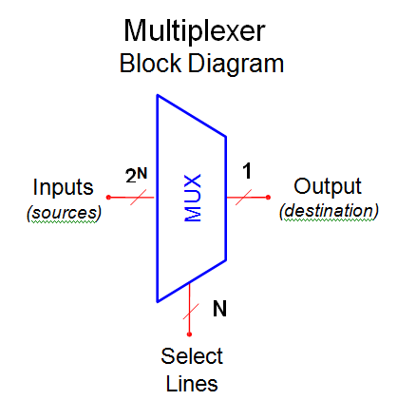

Slide 57
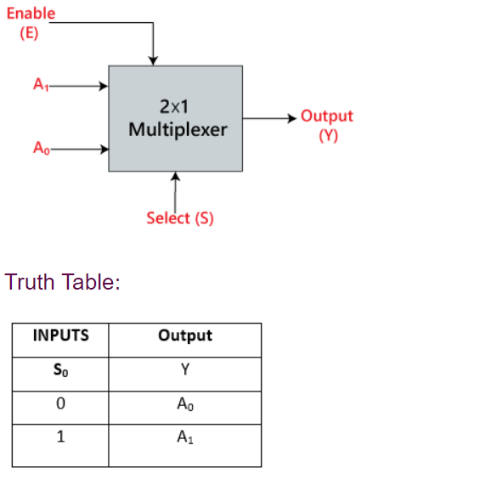
2×1 Multiplexer:

Slide 58
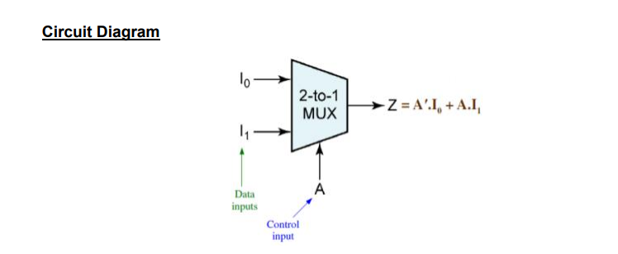

Slide 59
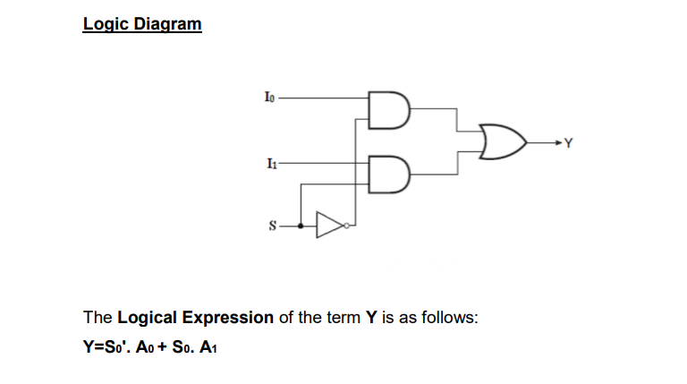

Slide 60
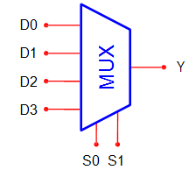
4×1 Multiplexer:

Slide 61
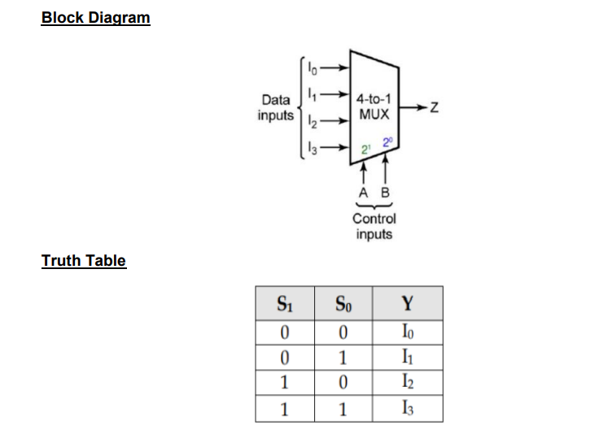

Slide 62
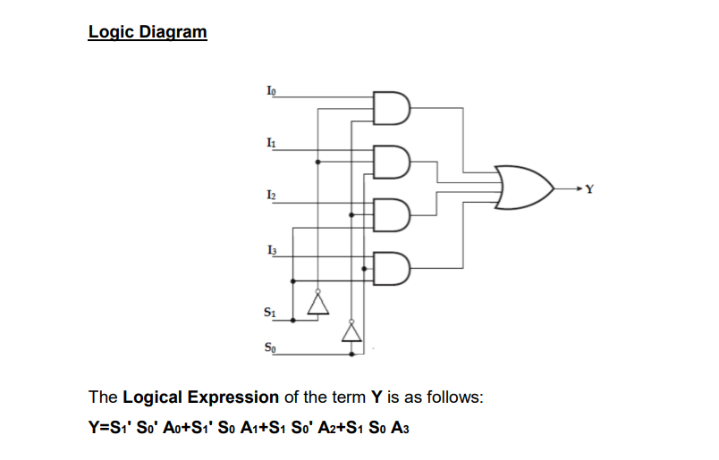

Slide 63
De-multiplexer
A De-multiplexer is a combinational circuit that has only 1 input line and 2^{N} output lines. Simply, the multiplexer is a single-input and multi-output combinational circuit.
De-multiplexer is opposite to the multiplexer

Slide 64
DEMUX Types
1-to-2(1selectline)
1-to-4(2selectlines)
1-to-8(3selectlines)
1-to-16(4selectlines)

Slide 65
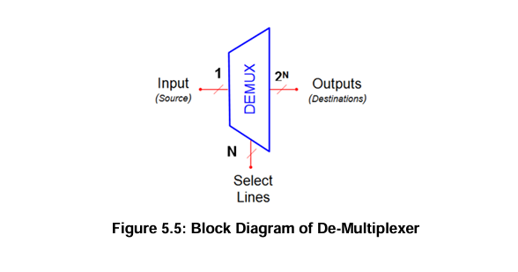

Slide 66
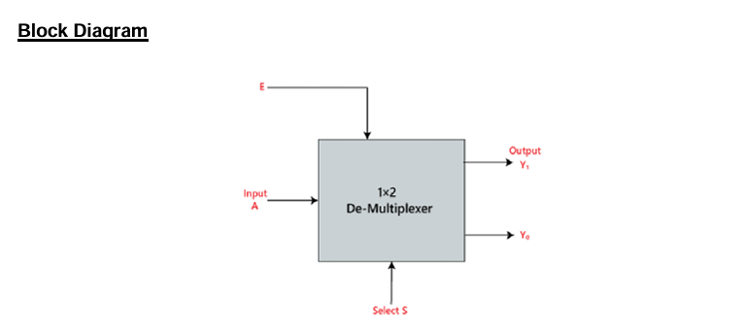
1×2 De-Multiplexer

Slide 67

1×2 De-Multiplexer

Slide 68


Slide 69

1×4 De-multiplexer

Slide 70


Slide 71


Slide 72

Sequential circuits:

Slide 73
FLIPFLOPS
A flip-flop is a binary storage device. It can store binary bits either 0 or 1. It has two stable states HIGH and LOW i.e. 1 and 0.

Slide 74
SR Flip Flop
It is a Flip Flop with two inputs, one is S and the other is R.
S here stands for Set and R here stands for Reset.
Set basically indicates set the flip flop which means output 1 and reset indicates resetting the flip flop which means output 0.
Here, a clock pulse is supplied to operate this flip-flop, hence it is a clocked flip-flop.

Slide 75


Slide 76


Slide 77
JK FLIP FLOP
The JK flip flop is used to remove the drawback of the S-R flip flop, i.e., undefined states.
The JK flip flop is formed by doing modification in the SR flip flop. The S-R flip flop is improved in order to construct the J-K flip flop.
When S and R input is set to true, the SR flip flop gives an inaccurate result. But in the case of JK flip flop, it gives the correct output.

Slide 78

JK Flip-Flop

Slide 79

Truth table

Slide 80


Slide 81

T Flip Flop
T here stands for Toggle.
Toggle basically indicates that the bit will be flipped i.e., either from 1 to 0 or from 0 to 1.

Slide 82

Truth table

Slide 83
D Flip Flop
D flip flop is an electronic devices that is known as “delay flip flop”

Slide 84


Slide 85


Slide 86
Basic Principle of Communication
Sending, receiving, and processing data among two devices are referred to as communication.
A communication system is a group of components (devices) that work together to establish a connection between both the sender and recipient.
Radio and television, satellite broadcasting, wireless telegraphy, mobile communication, and computer communication are some examples of communication systems.

Slide 87

Principles of Electronic Communication Systems

Slide 88
The main constituents of basic communication system are:
Information source and input transducer
Transmitter
Channel or medium
Noise • Receiver
Output transducer and final destination

Slide 89
Information Source and Input Transducer:
The physical form of information is represented by a message that is originated by an information source
For example, a sentence or paragraph spoken by a person is a message that contains some information. The person, in this case, acts as information source.
If the information produced by the source is not in an electrical form, it has to be converted into an electrical form using a transducer. Eg. Microphone
The electrical signal produced by transducer is called the baseband signal. It is also called a message signal, an information signal and is usually designated by s(t).

Slide 90
Transmitter:
Transmitter processes the base band signal received from transducer prior transmission
There are two following options for processing signals prior transmission:
the baseband signal, which lies in the low frequency spectrum, is translated to a higher frequency spectrum (Carrier communication system)
the baseband signal is transmitted without translating it to a higher frequency spectrum (Baseband communication system)
This process is Modulation.

Slide 91
Channel or Medium
The transmission medium between the transmitter and the receiver is called a channel.
Depending on physical implementations, channels can be classified into two groups:
Hardware Channels: These channels are manmade structure. The three possible implementations of the hardware channels are: Transmission lines, Waveguides, and Optical Fiber Cables (OFC)
Software Channels: These are certain natural resources. The natural resources that can be used as software channels are: air or open space and sea water.

Slide 92
Noise
Noise is defined as unwanted electrical energy of random and unpredictable nature
Receiver
The function of the receiver section is to separate the noise from the received signal, and then recover the original baseband signal by performing demodulation process.

Slide 93
Output Transducer & Final Destination
The recovered baseband signal is handed over to the final destination, which uses a transducer to convert this electrical signal to its original form.

Slide 94
Evolution of Communication systems
1G – First-Generation System
2G – Second-generation Communication System (GSM)
3G – Third-generation Communication System
4G –Fourth –generation communication system
5G – Fifth-generation Communication System

Slide 95
1G – First-Generation System
1G laid the foundation and opened the door to wireless telephone communication before us.
It used analog technology, was limited to voice calls, and offered a maximum speed of 2.4 kbps.
During 1G, cell phones were big, heavy, and expensive.
Also, battery drainage and poor voice quality were other limitations.

Slide 96
2G – Second-generation Communication System (GSM)
The Global System for Mobile Communications (GSM), the second generation (2G) standard developed by the European Telecommunications Standards Institute (ETSI), is based on Time Division Multiple Access (TDMA)
The 2G mobile phones used digital modulation and enabled a maximum speed of 14.4 kbps. Voice calls and SMS were supported, and mobile phones got smaller and more secure.

Slide 97
3G – Third-generation Communication System
The advent of 3G networks in the first decade of the century paved the foundation for high-speed internet and wireless applications. Further, it resulted in a digitally powered era in communications.
Also, 3G paved the way for video call and streaming services

Slide 98
How is 4G Different from 3G?
4G was commercially deployed in 2009. The 3G network only uses IP for data, enabling voice with a circuit-switched network.
On the other hand, 4G is an all-IP-based standard for both voice and data

Slide 99


Slide 100
5G – Fifth-generation Communication System
5G network is not just about providing huge data rates.
It can create an adaptive, flexible network that can connect virtually everything, including machines, objects and devices

Slide 101
What Makes 5G Exciting?
The 5G NR technology, including millimeter wave (mmWave) and massive Multiple-Input Multiple-Output (MIMO) with beamforming
enables a network to deliver very high speed, reduced low latency and more data capacity.
The peak data rate of the network for the download link is 20 Gbps and 10 Gbps for uplink and offers a latency of less than 1 millisecond

Slide 102


Slide 103


Slide 104


Slide 105


Slide 106


Slide 107
Boolean Algebra Theorems
De Morgan’s First Law:
De Morgan’s First Law states that (A.B)’ = A’+B’.

Slide 108


Slide 109

De Morgan’s Second Law: De Morgan’s Second law states that (A+B)’ = A’. B’.

Slide 110


Slide 111


